Slide 1
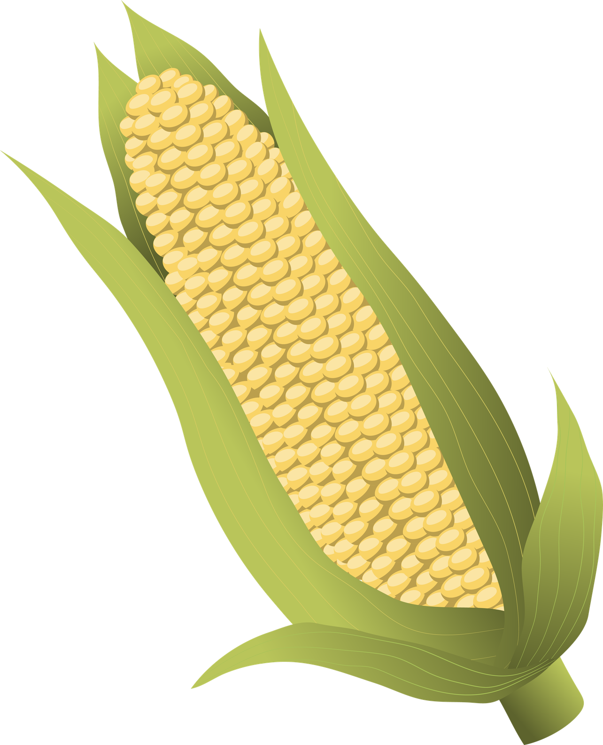
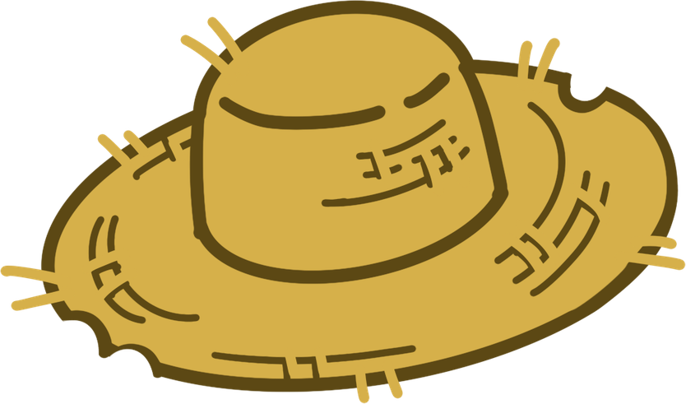
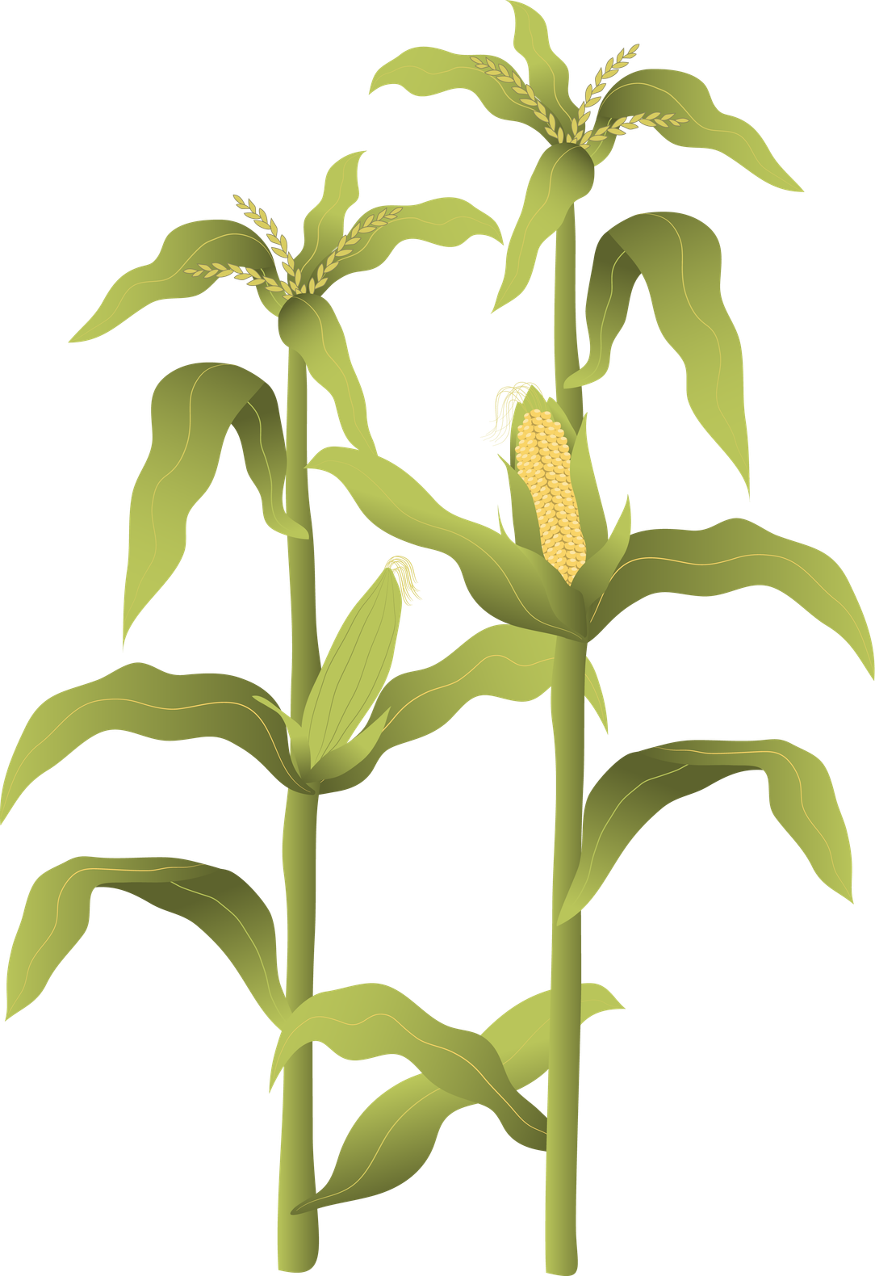
FUNGICIDE EXPLORATION
The Effects of Different Fungicides on the Yields of Corn Crops
BIS15L | Group 11

Slide 2
Our Group
Vaishnavi Maganti
Alejandro Acevedo
Catalina De Amorrortu

Slide 3
Our Data and Goal
Meta-analysis of yield response of foliar fungicide-treated hybrid corn in the United States and Ontario, Canada - Research conducted by Kiersten A. Wise et al. This research explores the effectiveness of different brands and application methods of fungicides on corn crops across the south midwestern U.S. and Ontario, Canada.
Our goal is to create a shiny app that will allow the user to input a state, and see what fungicide provided the highest yield, therefore determining the most effective fungicide for their use.
Limitations of this study and our exploration include the locations, as only 13 US states and one Canadian province are tested. The data is also limited to only two years, so there is a chance for new, more effective fungicides to have come to the market, and also for fungicide-resistant strains of fungi to have risen and continue to affect crops despite fungicide use.

Slide 4
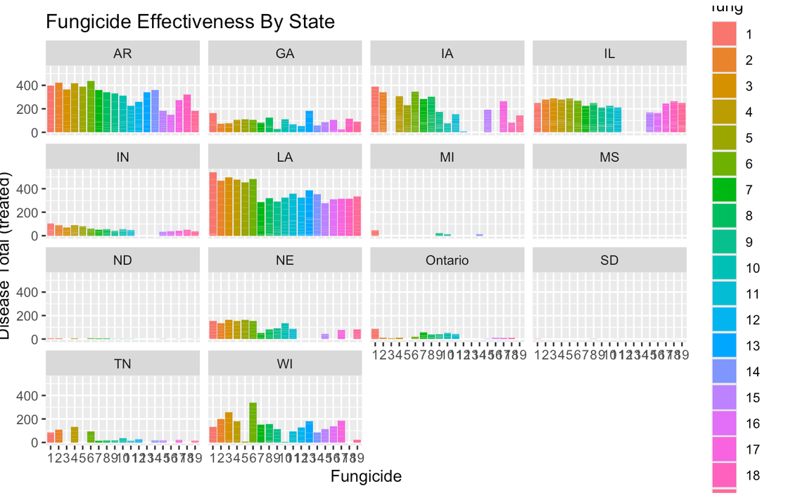
Data
Fungicide effectiveness by state.
Comparing the change in treated and untreated yields by fungicide per state.
We see that MD, SD, and ND have almost no effective treatments, and all states except AR, GA, and LA have at least one fungicide that does not work

Slide 5
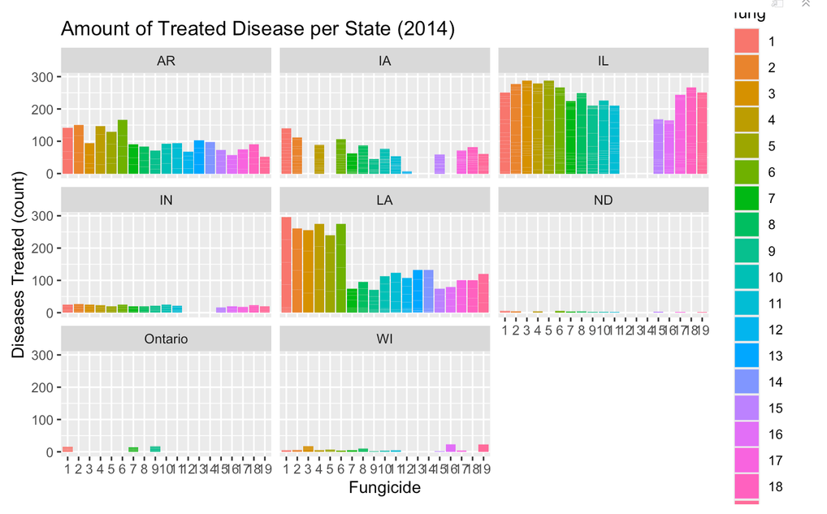
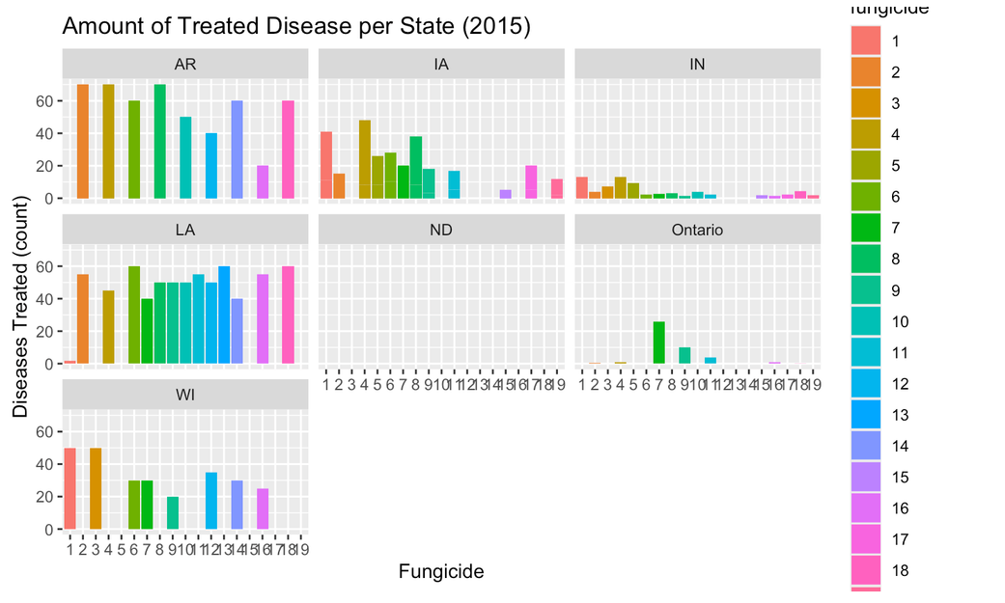
Data
Fungicide resistance
Comparing the change in the total disease by fungicide and state in 2014 and 2015, we can determine if any fungicide-resistant strains appeared
2014
2015
*IL was not tested in 2015, so it has been removed from the 2015 graphs.*

Slide 6
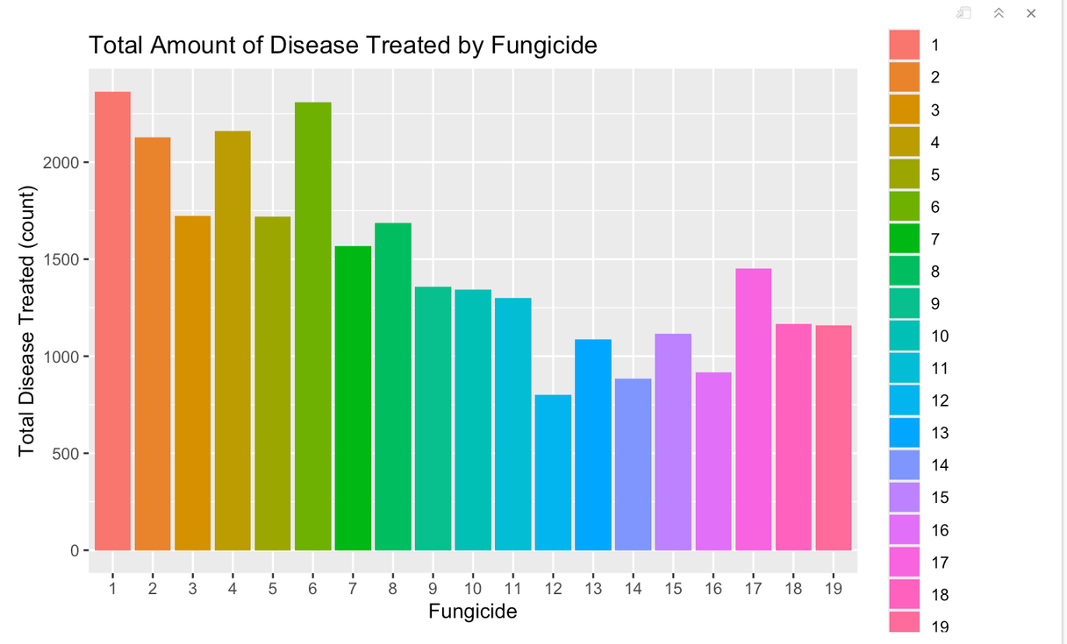
Data
Overall, which fungicide treats the highest amount of diseases/fungi?

Slide 7
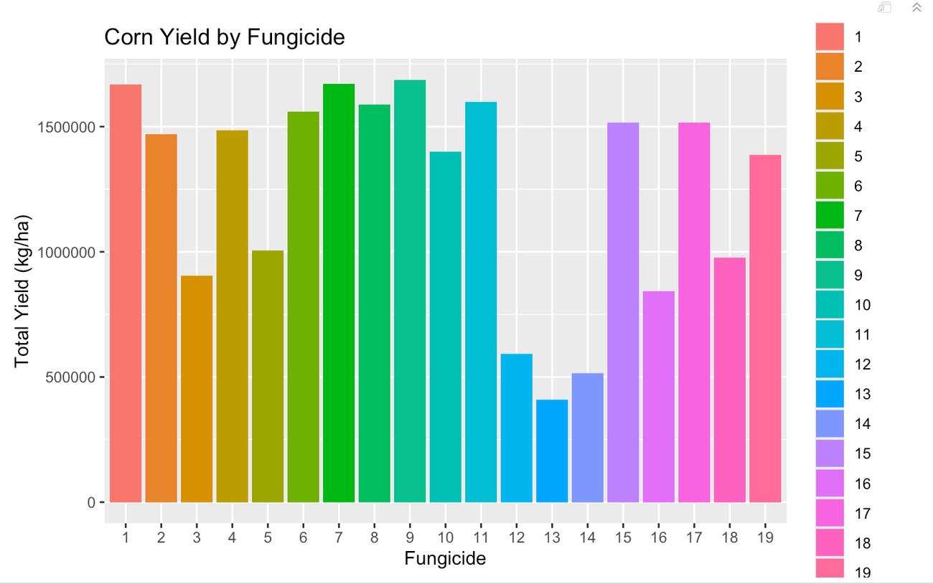
Data
Overall, which fungicide provides us with the highest yield of corn?

Slide 8
Shiny App

Slide 9
Thank You

